Slide 1


Laptop Price Prediction
Technical Analysis
About 90% of the World’s Currency Only Exists on Computers.

Slide 2
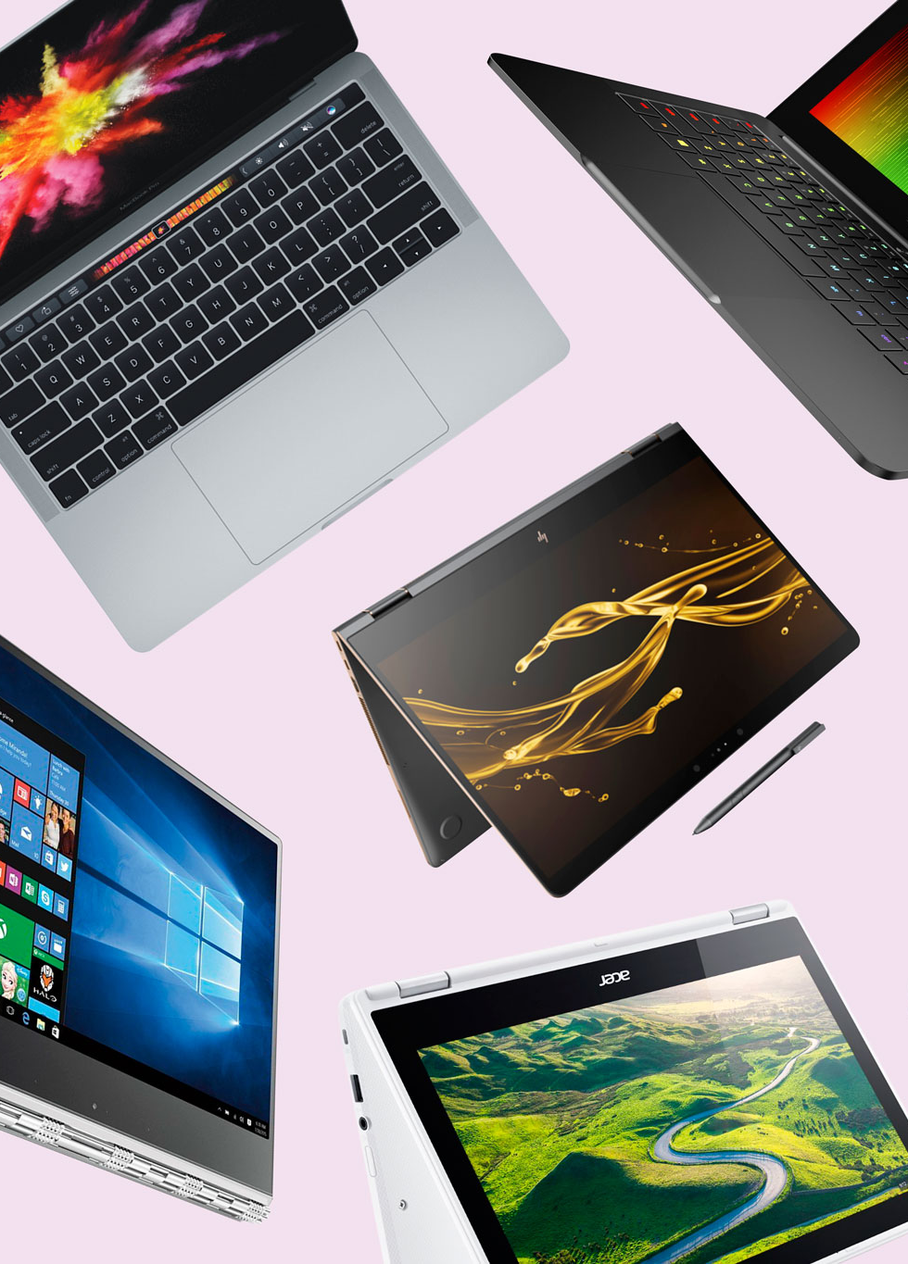
Table of Content
Problem Statement
Overview of Dataset
Data Wrangling
Exploratory Data Analysis
Algorithms and Machine Learning
Prediction
Future Scope and Motivation
Acknowledgement

Slide 3

Problem Statement
If any user wants to buy a laptop then our application should be compatible to provide a tentative price of laptop according to the user configurations.

Slide 4

Dataset
Kaggle Dataset
1300+ laptops records
12 features
Noisy Columns, contain lots of information
The only problem is we are having less data but we will obtain a good accuracy over it. The only good thing is, it is better to have a large data.

Slide 5

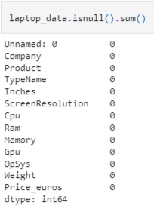
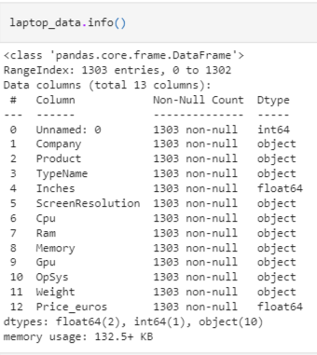
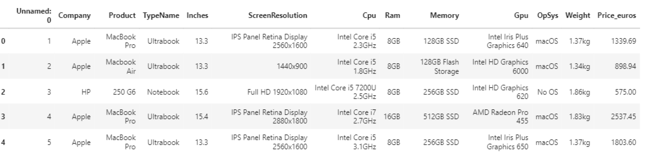

YAY!
Data Wrangling

Slide 6

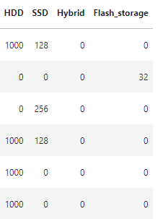
Data Wrangling
Storage Type
Storage Capacity
Data Wrangling
SSD + HHD
Storage capacity units

Slide 7
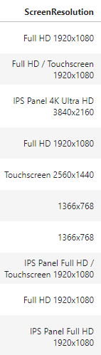
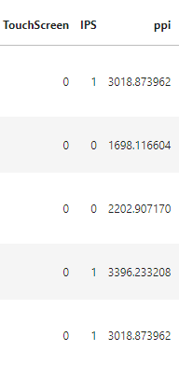
Data Wrangling
Touchscreen
Data Wrangling
IPS
Screen Resolution
dddd X dddd

Slide 8



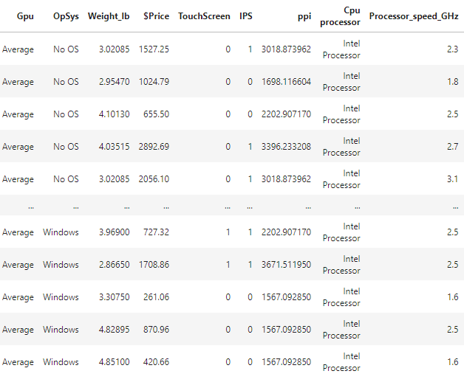
Data Wrangling
Data Wrangling

Slide 9

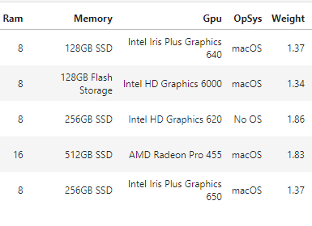
Data Wrangling
Data Wrangling

Slide 10
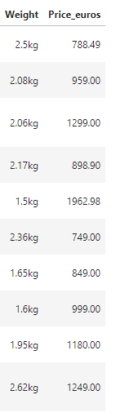
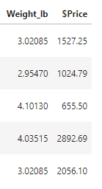
Data Wrangling
1 kg ≈ 2.205 lb
Data Wrangling
1 Euro ≈ 1.14 USD

Slide 11

Exploratory Data Analysis

Slide 12
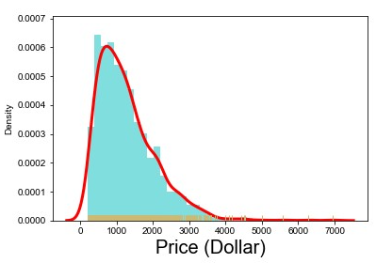
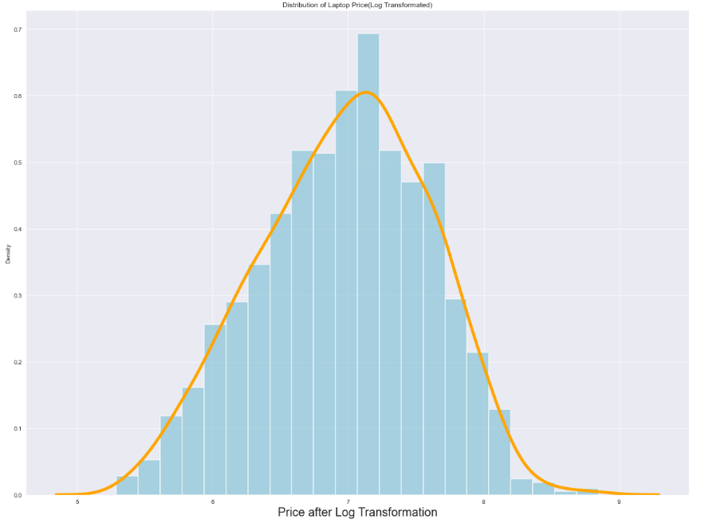
Exploratory Data Analysis
Log Transformation
Skewed Target variable
Normal Target variable
The log transformation can be used to make highly skewed distributions less skewed. This can be valuable both for making patterns in the data more interpretable and for helping to meet the assumptions of inferential statistics.

Slide 13
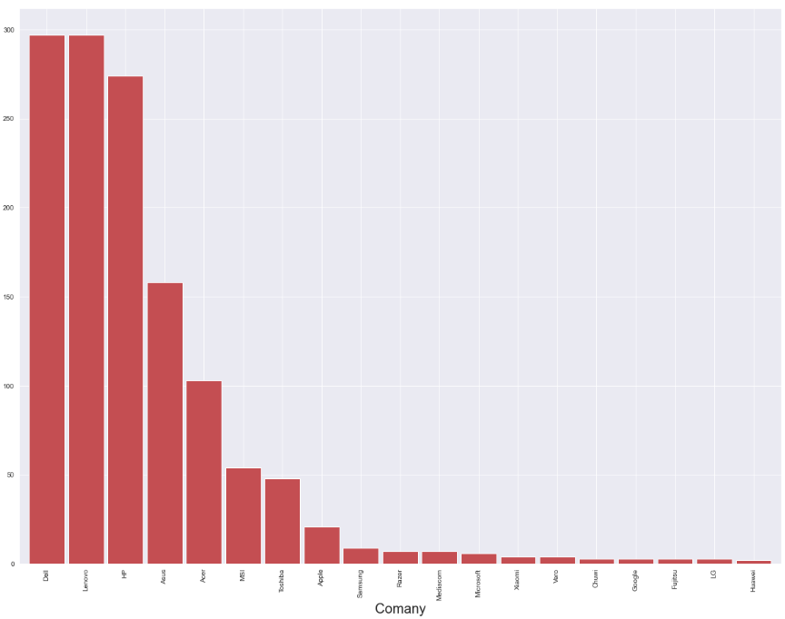
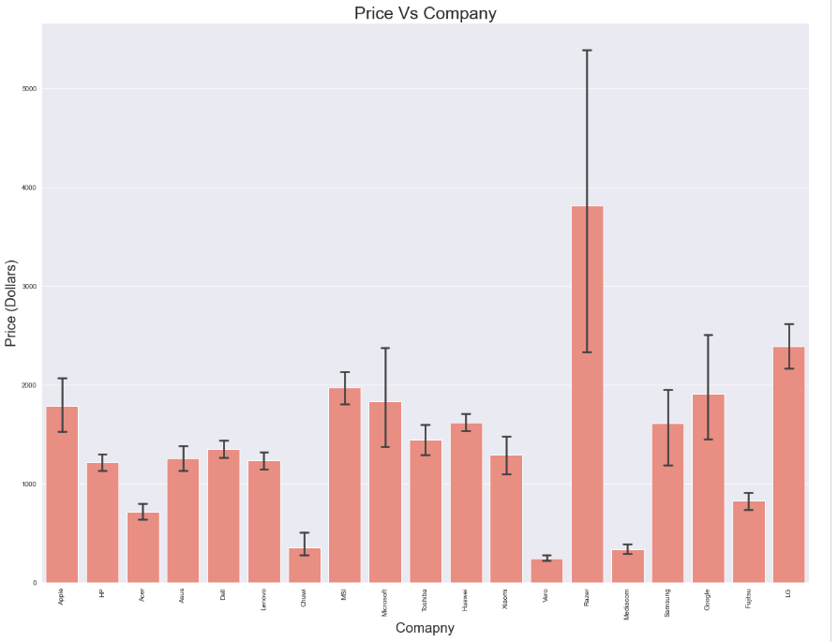
Exploratory Data Analysis
How the brand name impacts the laptop price?
What is the average price of each laptop brand?
High demand Brand
Dell
Lenovo
HP
Asus
Acer
Higher Price Range
Razer
LG
Google
Samsung
Microsoft
MSI
Apple

Slide 14
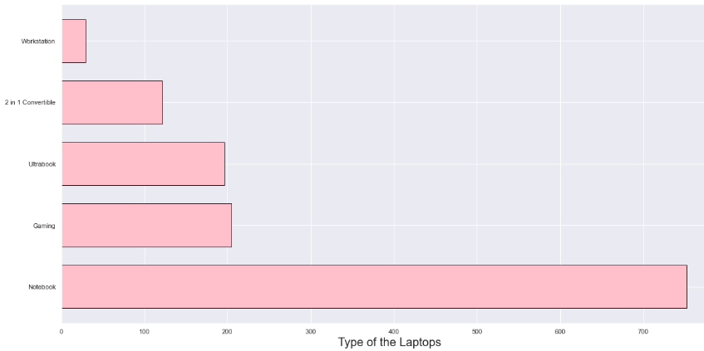
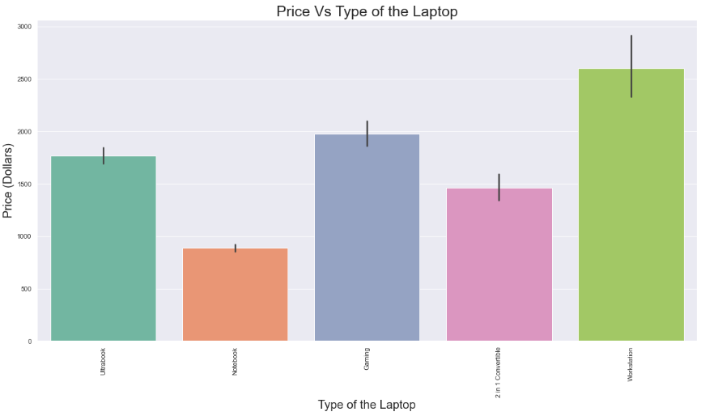
Exploratory Data Analysis
Which type of laptops are in demand?
What is the average price of each laptop type?
High demand Type
Notebook
Higher Price Range
Workstation
Gaming
Ultrabook

Slide 15
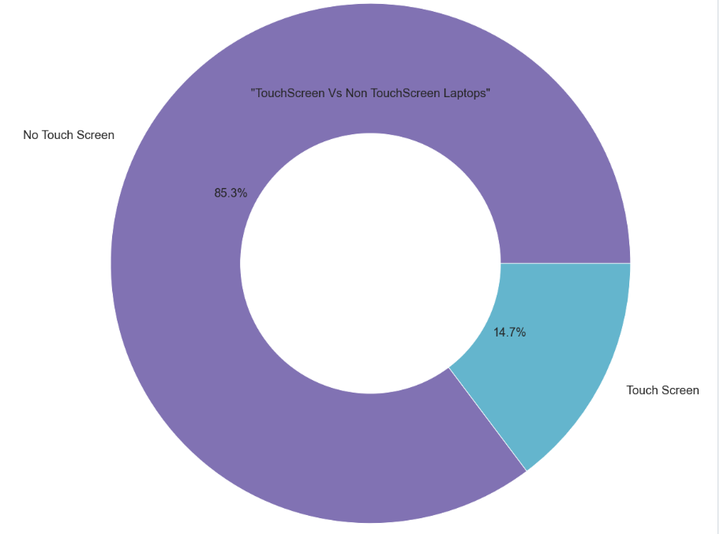
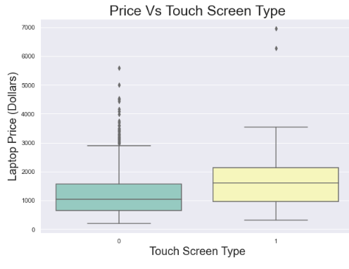
Exploratory Data Analysis
What is the ratio of Touchscreen Vs No touchscreen laptops?
What is the average price of each laptop screen type?
Touch Screen:
14.7 %
No Touch Screen:
85.3%
Higher Price Range
Touch Screen

Slide 16
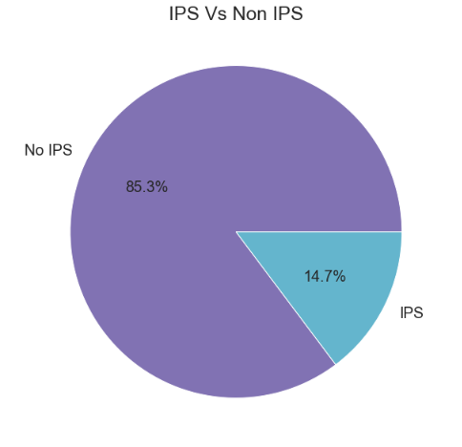
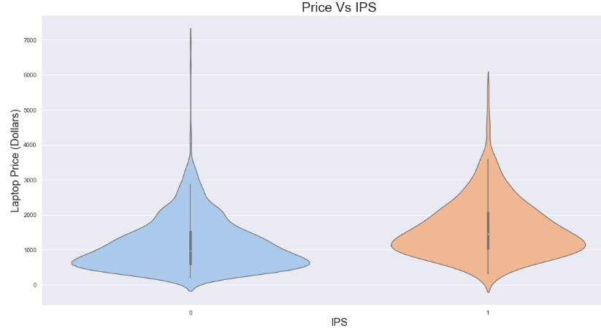
Exploratory Data Analysis
What is the ratio of IPS Vs No Non IPS laptops?
What is the average price of each laptop if having or not having IPS?
Non IPS:
85.3%
IPS:
14.7%
Higher Price Range
IPS
IPS stands for in-plane switching, a type of LED (a form of LCD) display panel technology. IPS panels are characterized as having the best color and viewing angles.

Slide 17
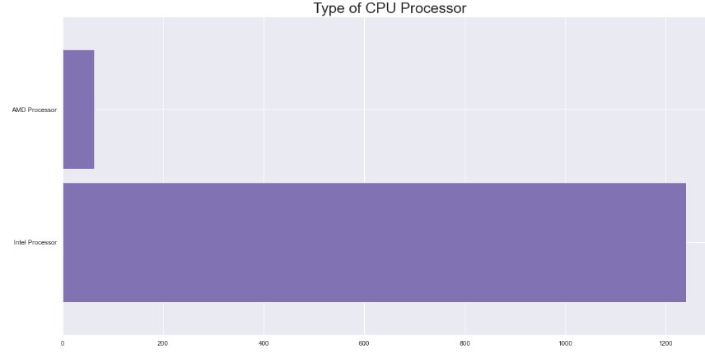
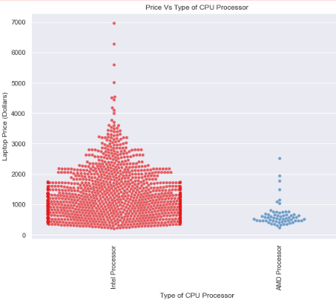
Exploratory Data Analysis
Which type of CPU Processors are in demand?
What is the average price of each CPU Processors type?
High demand Type
Intel
Higher Price Range
Intel

Slide 18
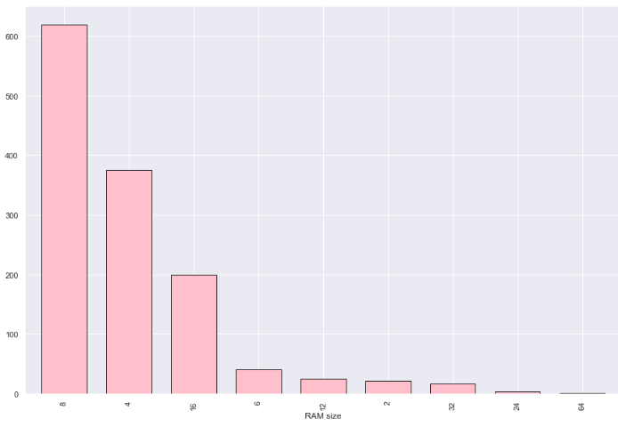
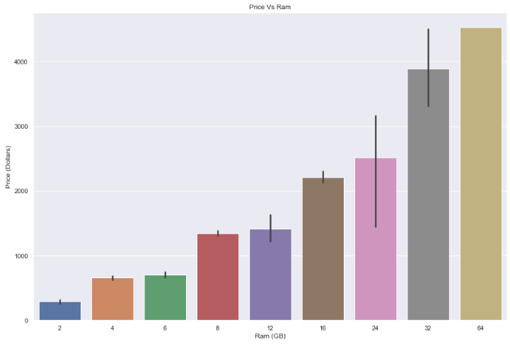
Exploratory Data Analysis
Which type of RAM is in demand?
What is the relation between Ram and Price?
High demand Type
8 GB
4 GB
16 GB
Price highly correlated with
RAM

Slide 19
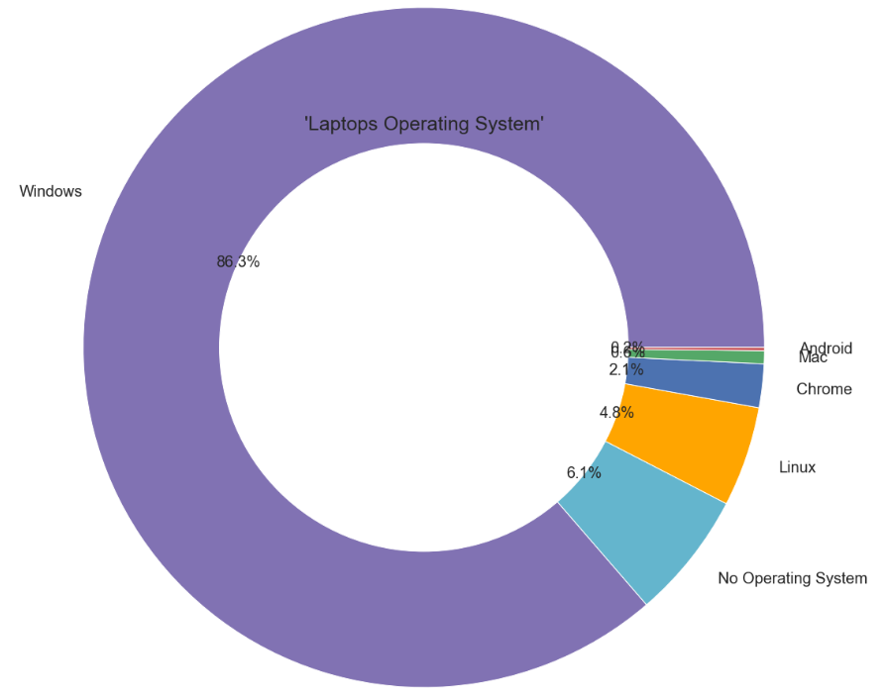
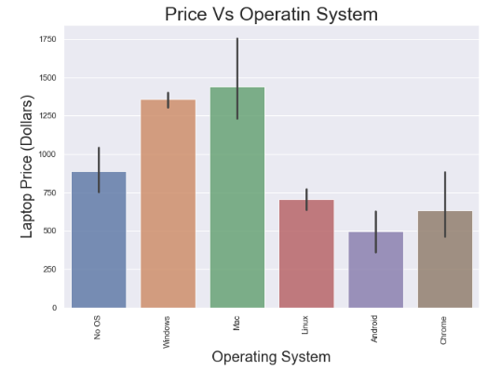
Exploratory Data Analysis
Which type of operating system is in demand?
What is the average price of each Operating System?
High demand Type
Windows
Higher Price Range
Mac
Windows

Slide 20
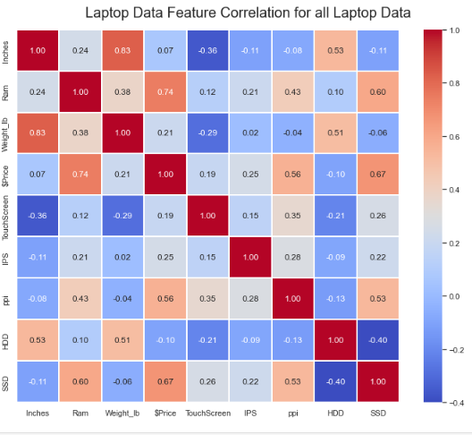
Algorithms and Machine Learning
ρ = Corr (Price, RAM)
ρ = Corr (Price, SSD)

Slide 21
Algorithms and Machine Learning
Name of the Algorithm | R2 Percentage | Mean Absolute Error
Linear Regression | 79.07% | 0.23
Ridge Regression | 79.09% | 0.23
Lasso Regression | 79.12% | 0.23
K Nearest Neighbor | 82.90% | 0.20
Decision Tree | 81.42% | 0.21
Random Forest | 88.09% | 0.17
Gradient Boosting | 89.60% | 0.16
Support Vector Regression | 89.59% | 0.16

Slide 22
Prediction
By taking various features like Storage size, Storage Capacity, processor speed (GHz), Company Name, etc.; you can predict price of your desired laptop!
Future Scope
Use different Techniques of Encoding Data
Hyper-parameter tunning can improve the performance.
Motivation
Although it looks like a simple project or just developing a model, the dataset we have is noisy and needs lots of feature engineering, and preprocessing that will drive your interest in developing this project. Laptop Price Prediction is an important problem. With a successful model for Laptop Price Prediction, we can choose better option! The motivated idea is that, if we know all information about laptop’s features, the price is predictable. In 2021, 340 million laptops are forecast to be shipped; this project is for all those 340 million lives!

Slide 23
Acknowledgement
I would like to Thank You
Travis Oliphant for maintaining NumPy library,
Wes McKinney for maintaining Pandas library,
John D. Hunter for inventing Matplotlib,
Michael Droettboom for maintaining Matplotlib,
Michael Waskom for creating Seaborn,
David Cournapeau for inventing Scikit-learn,
Daniel Wu for guiding me in this project.

Slide 24

Rutvimgohel@gmail.com
https://www.linkedin.com/in/rutvigohel-datascience/
https://github.com/PassionateDataScientist

